Slide 1


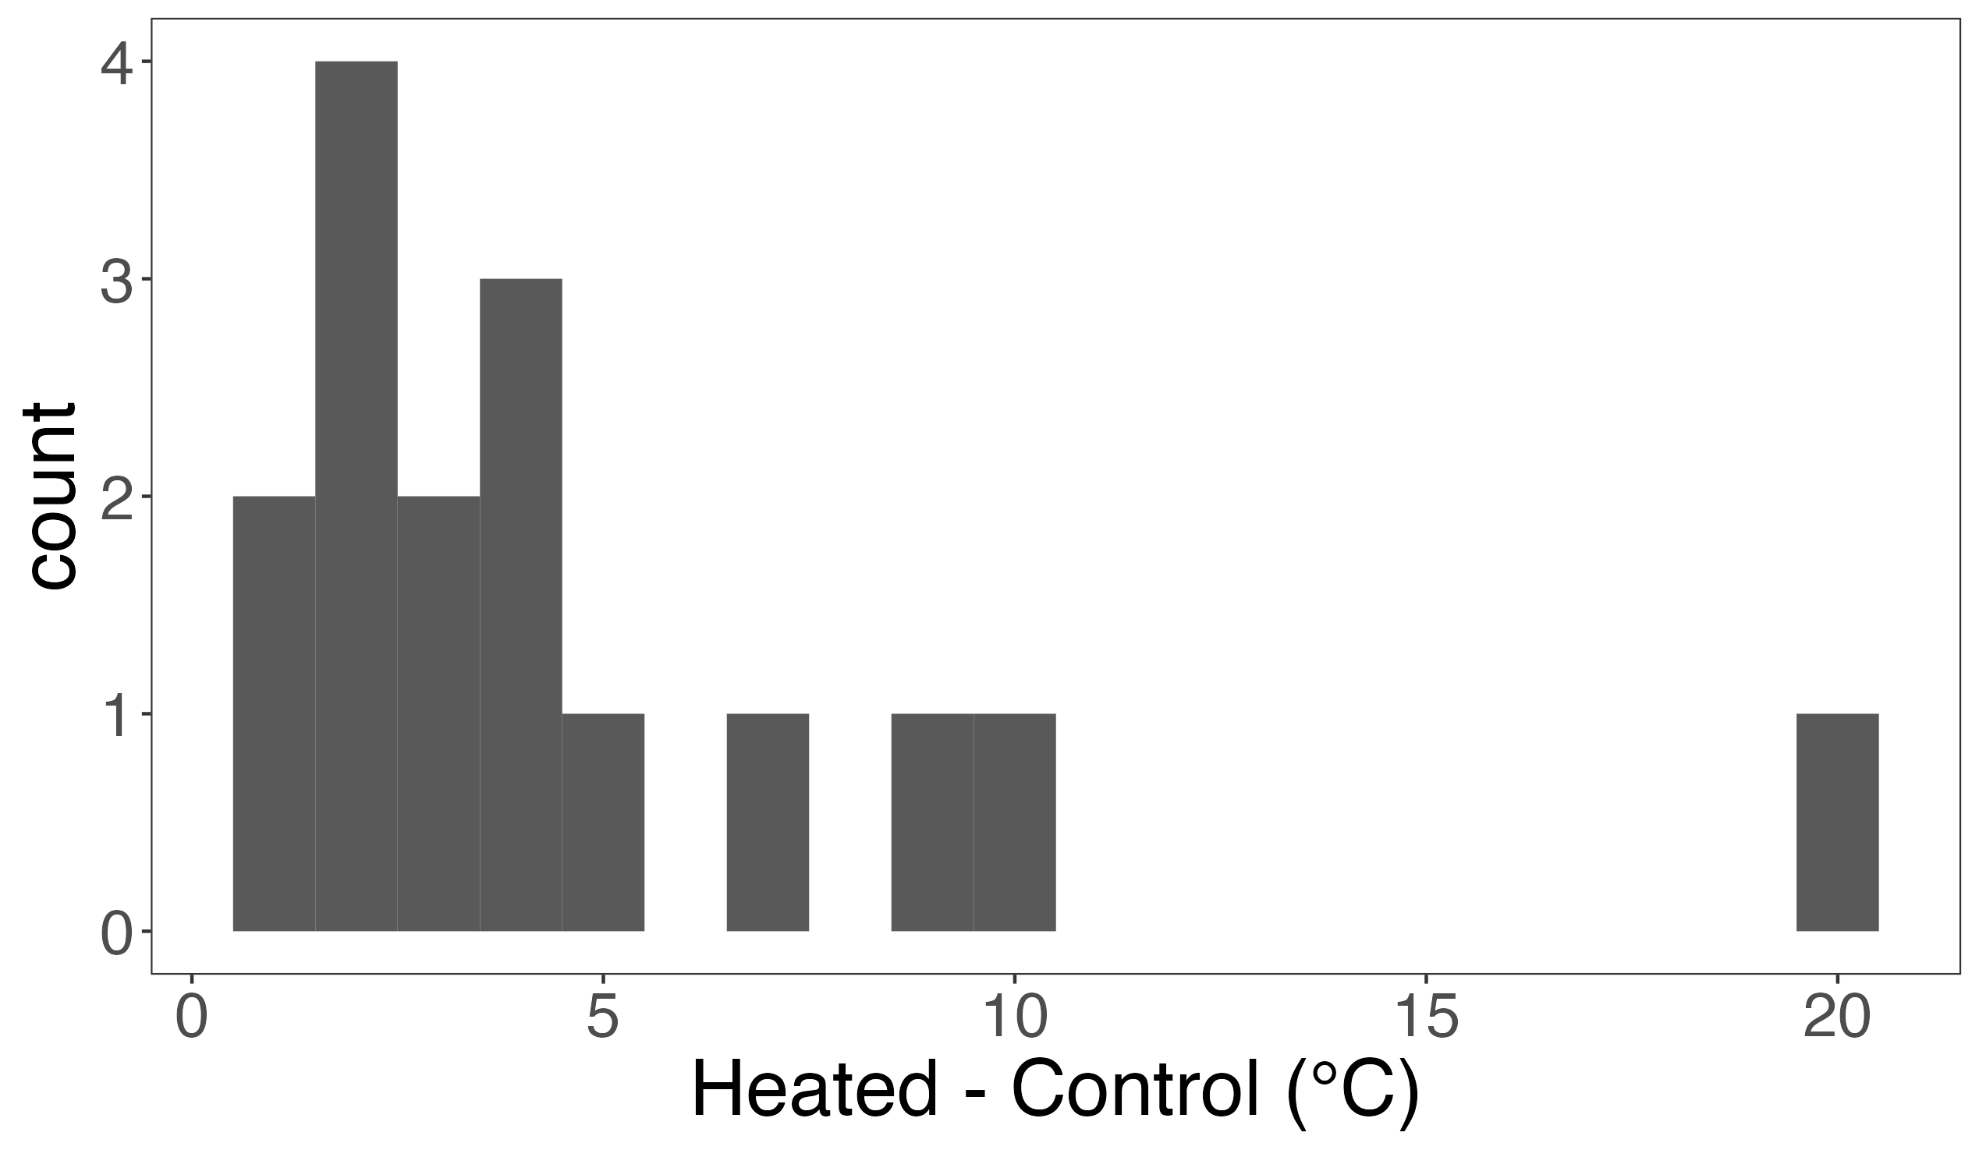
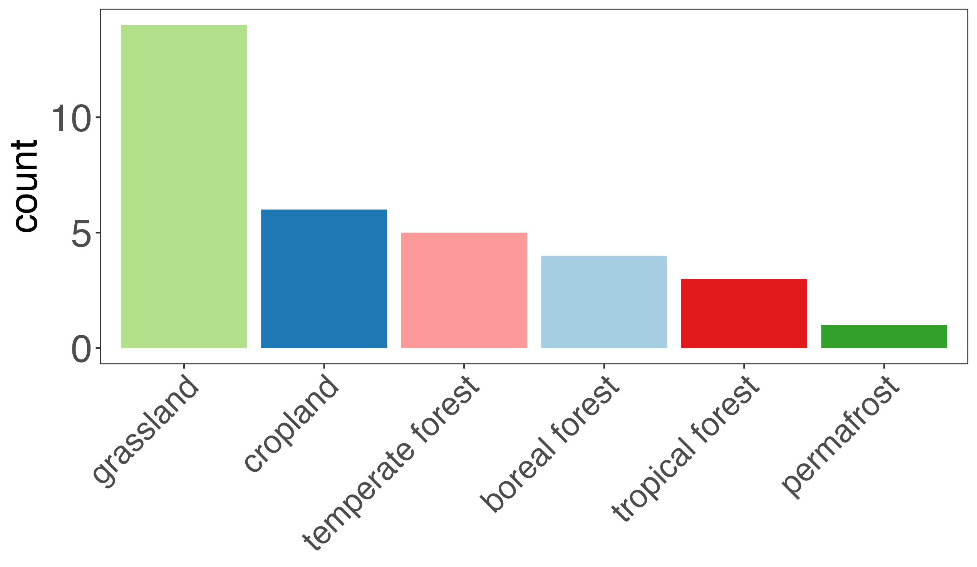
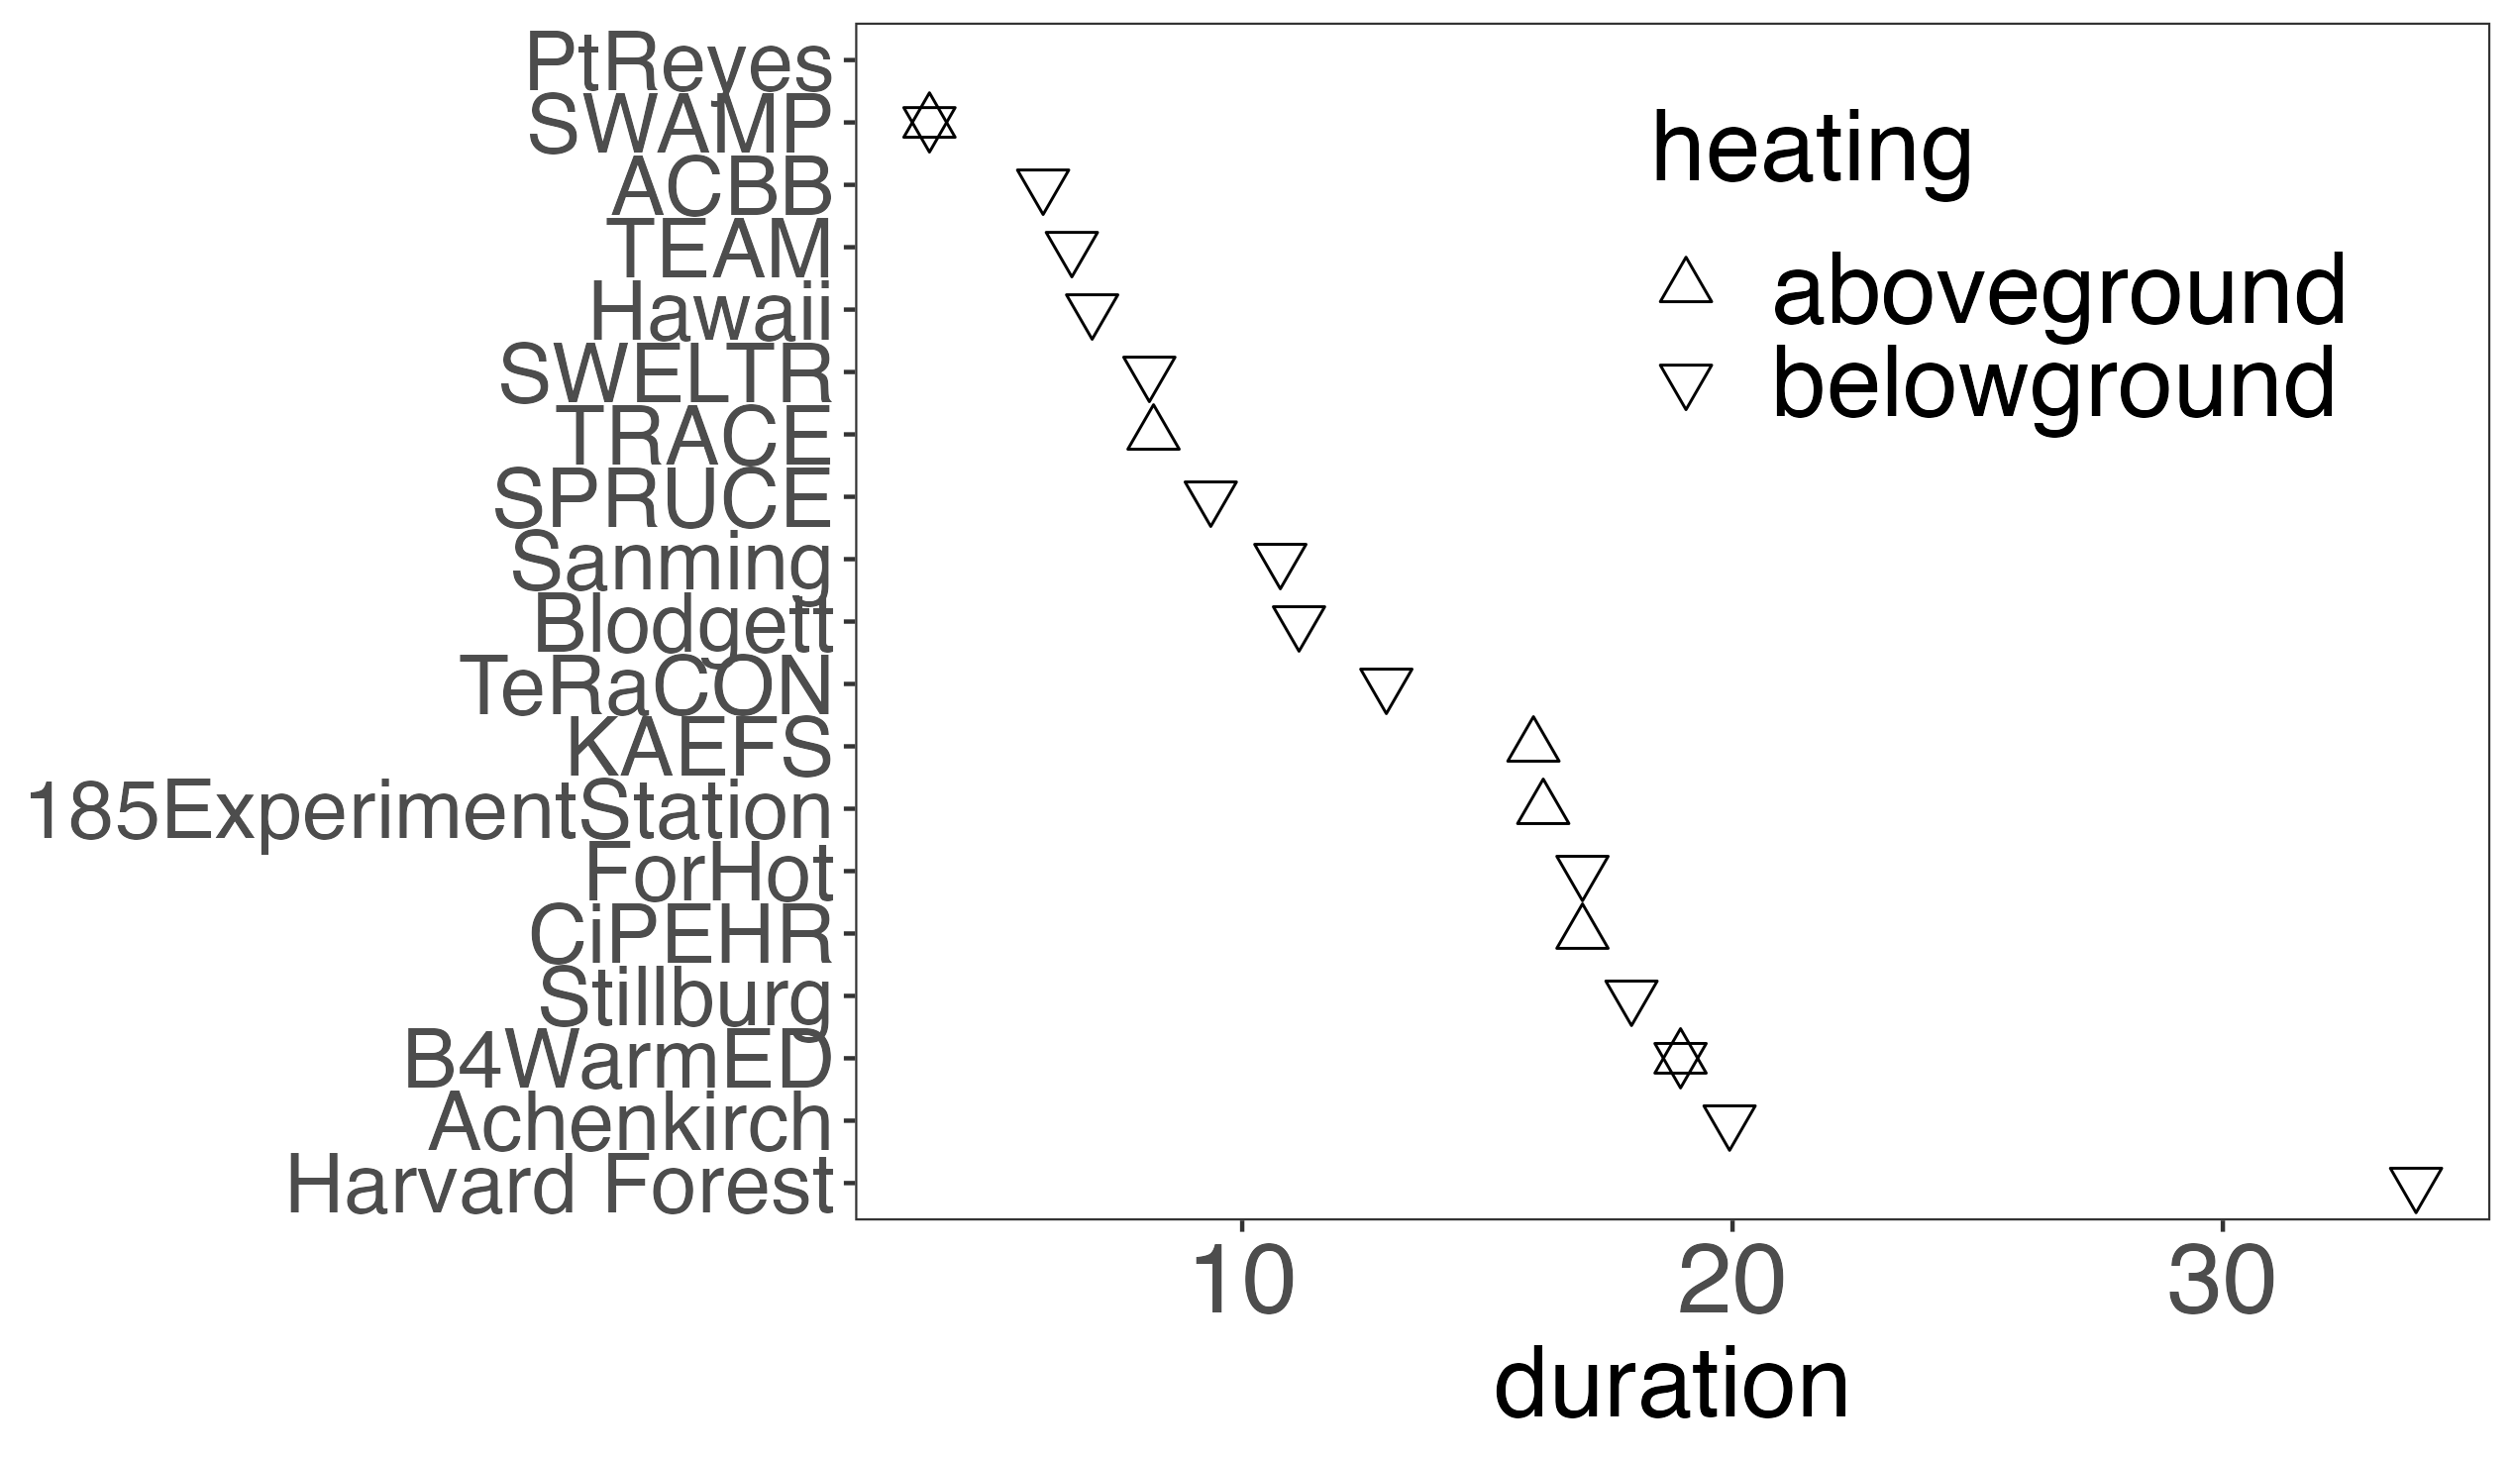
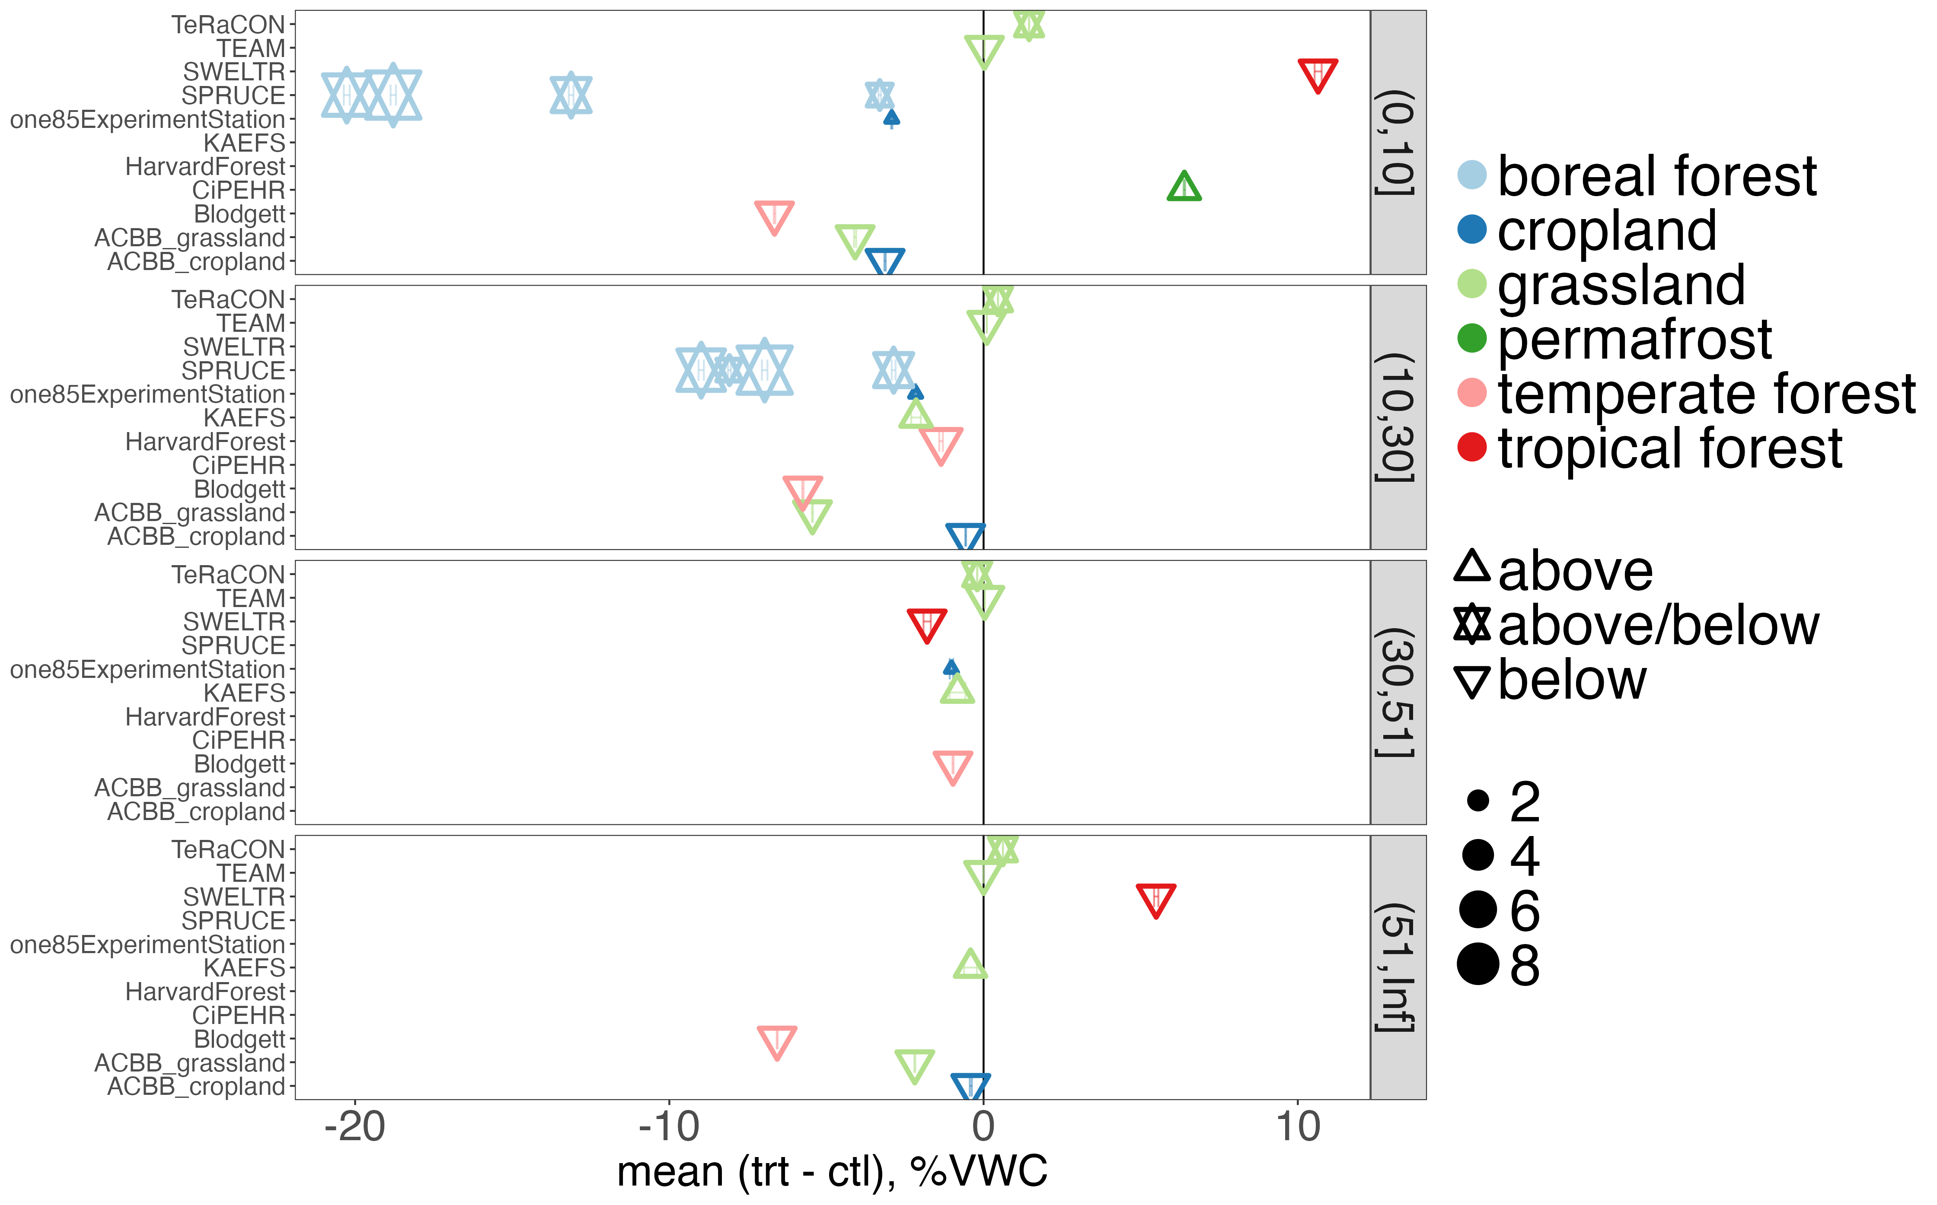
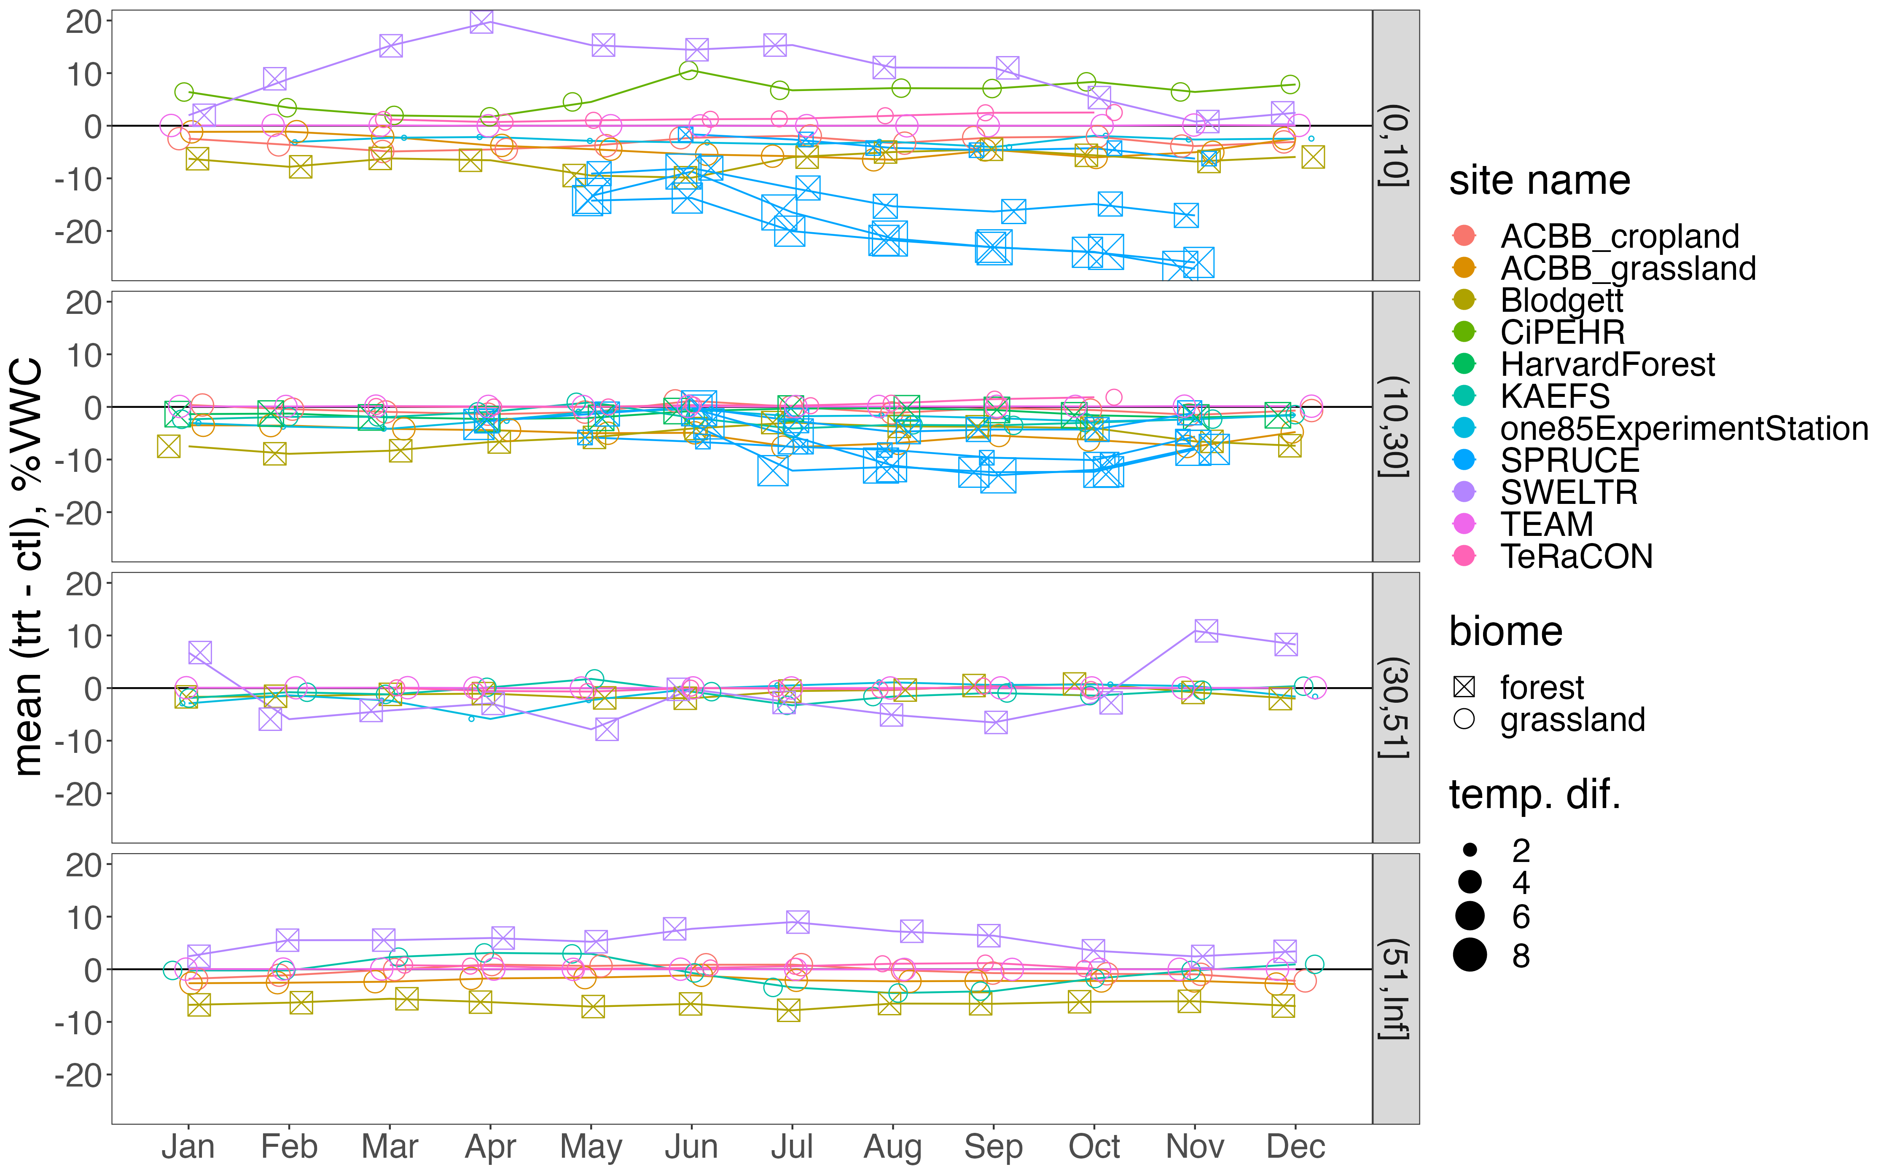
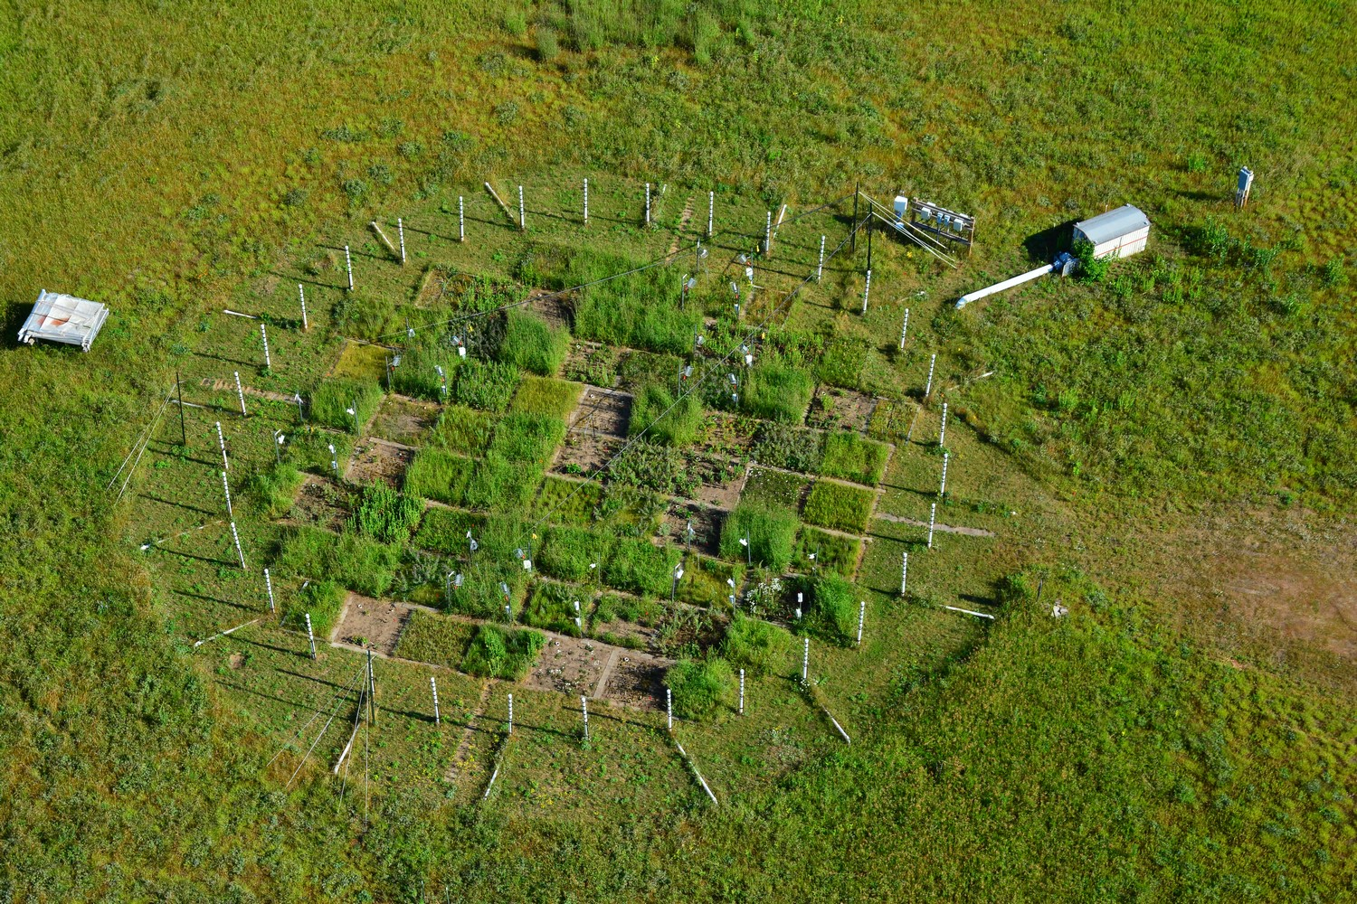
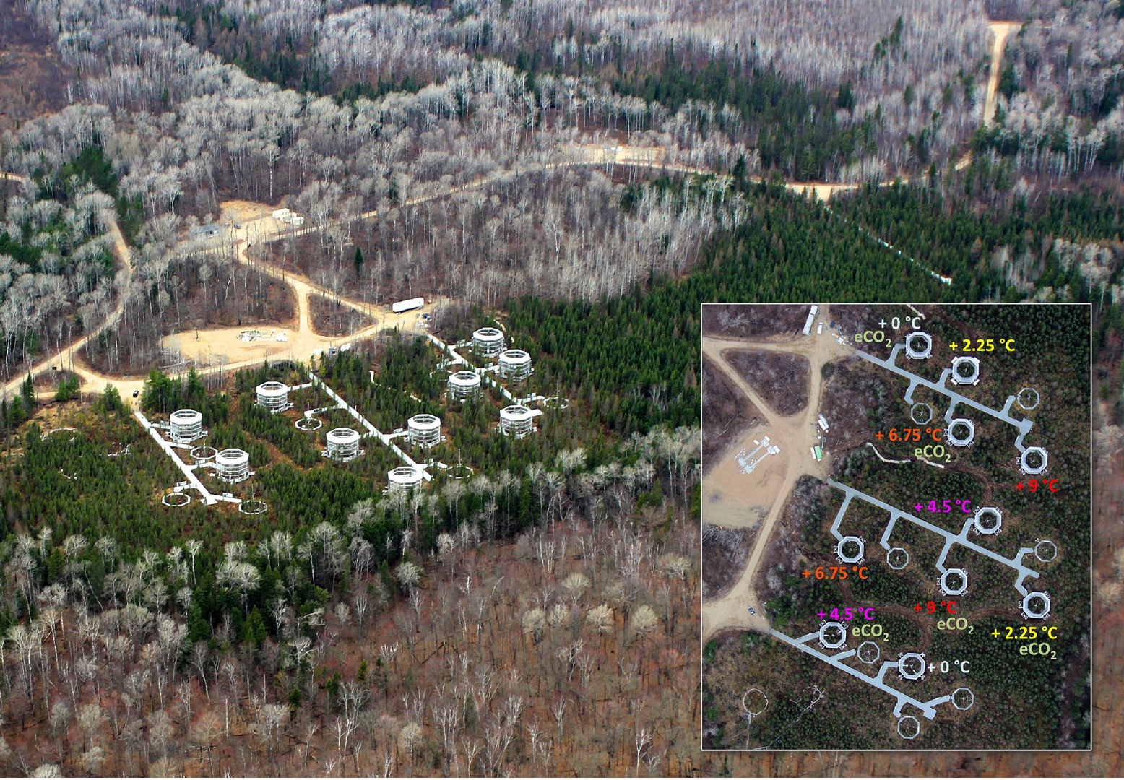
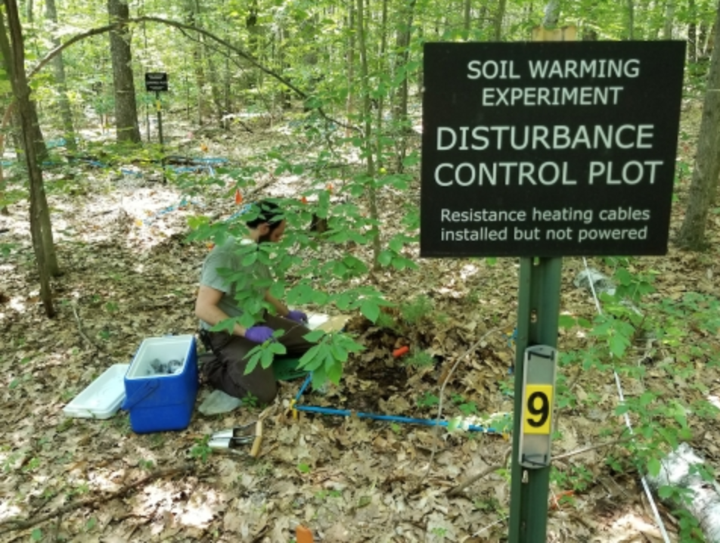
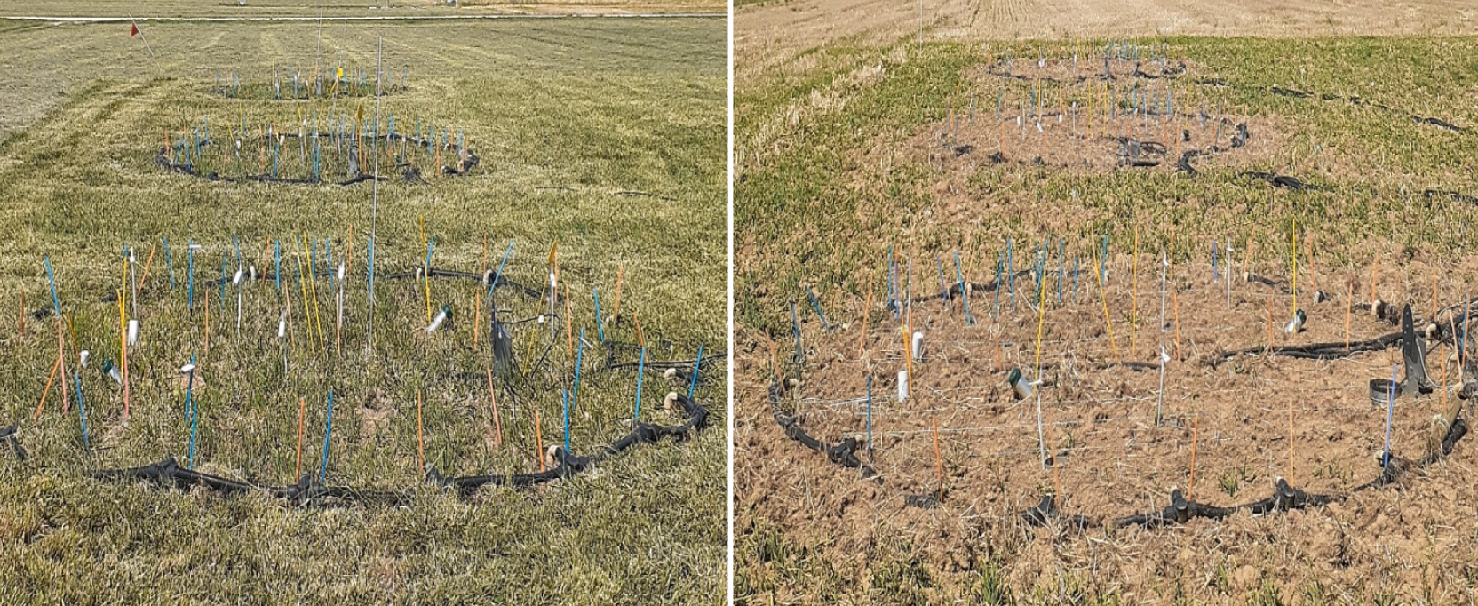
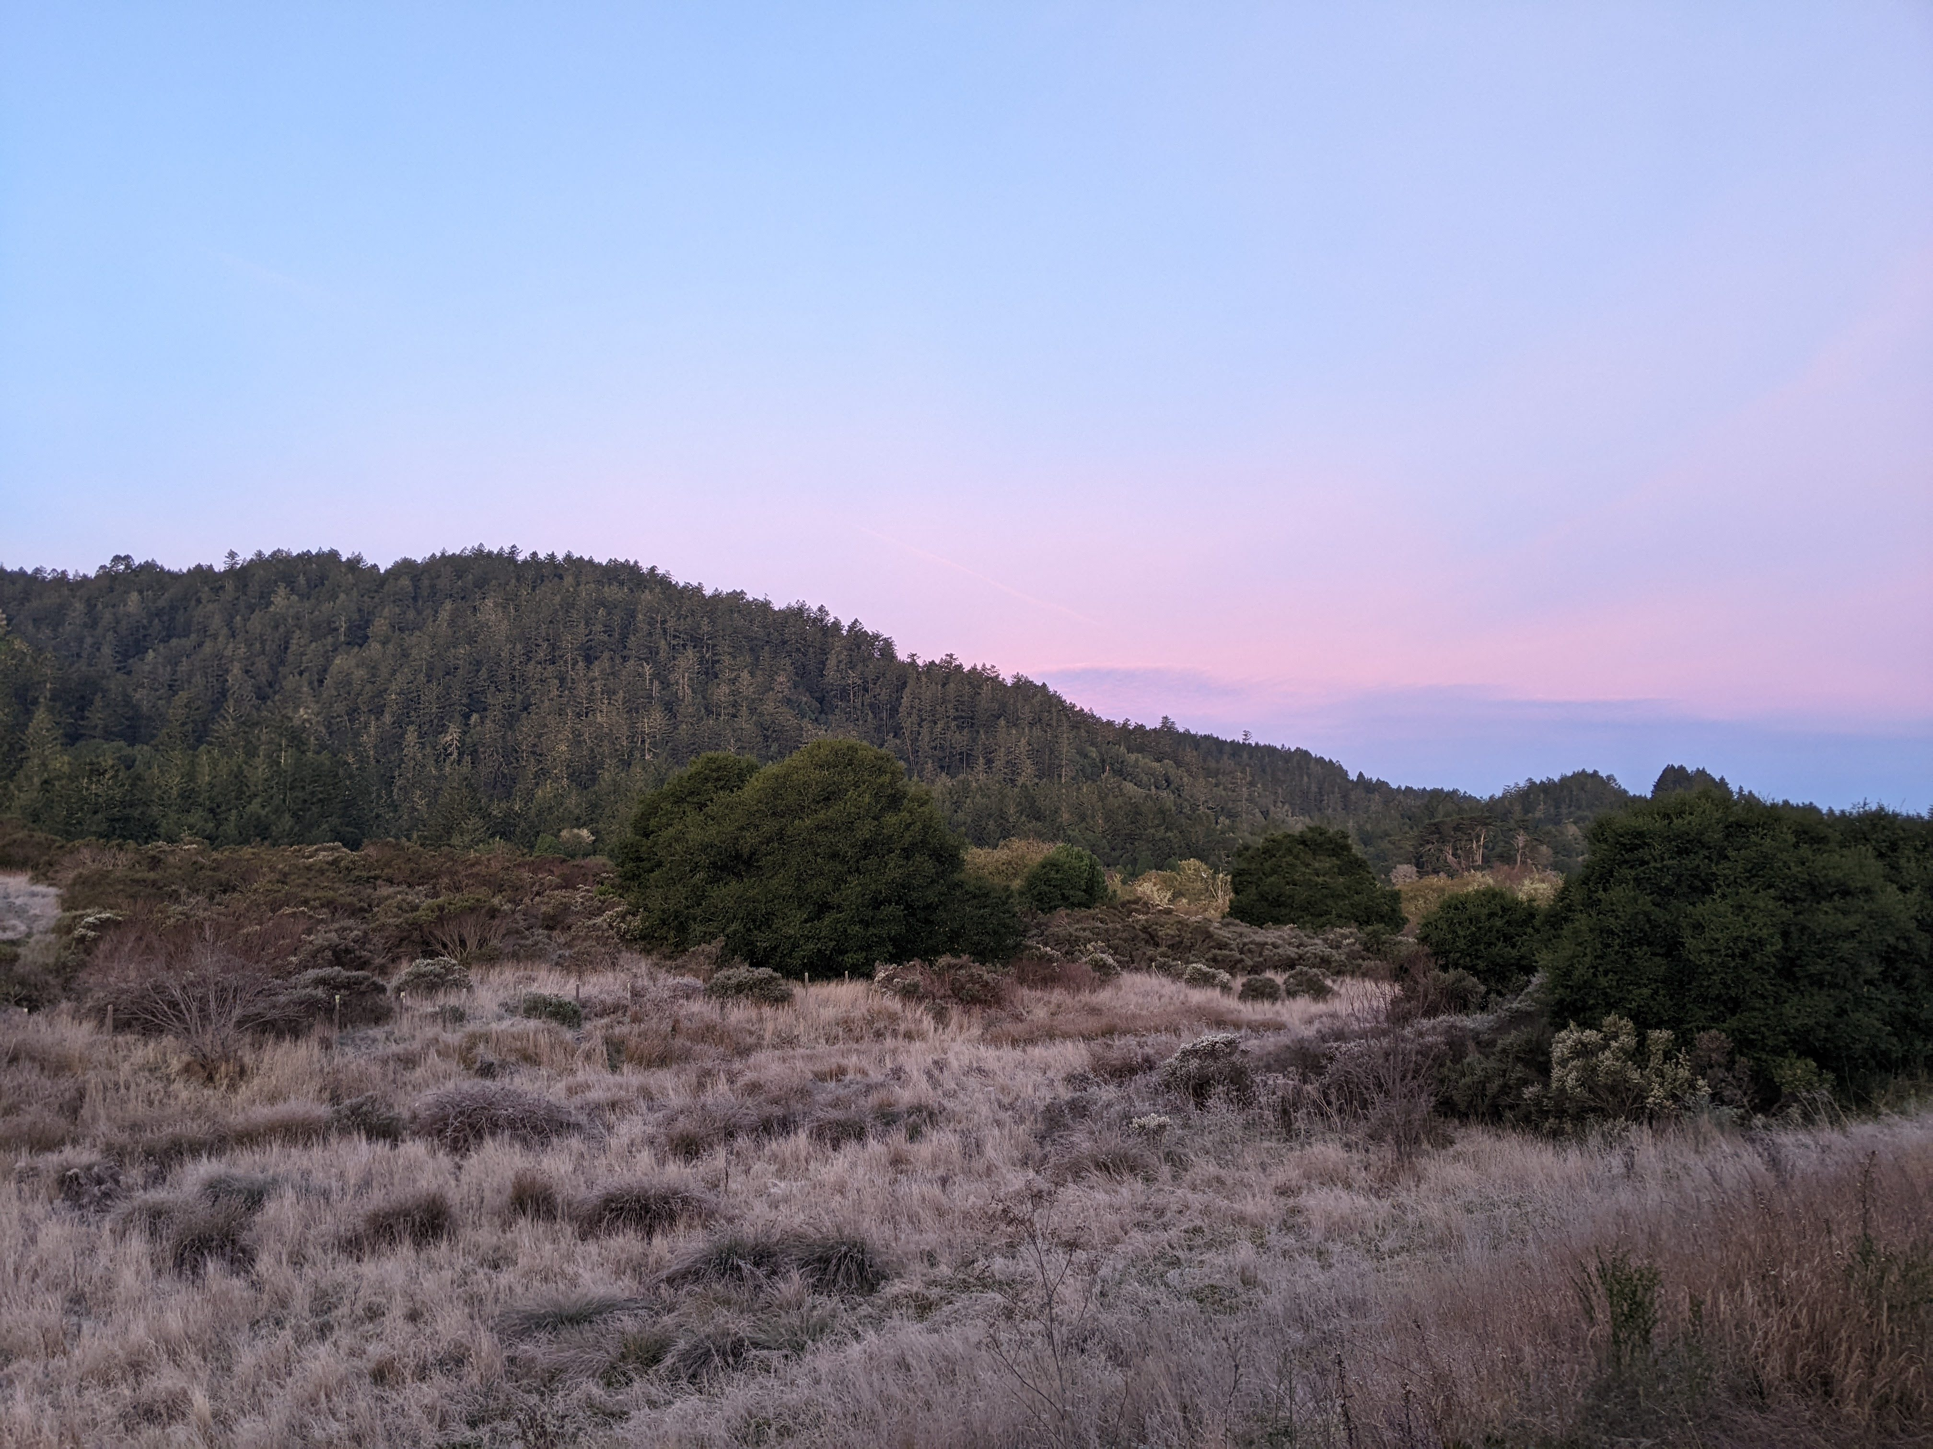
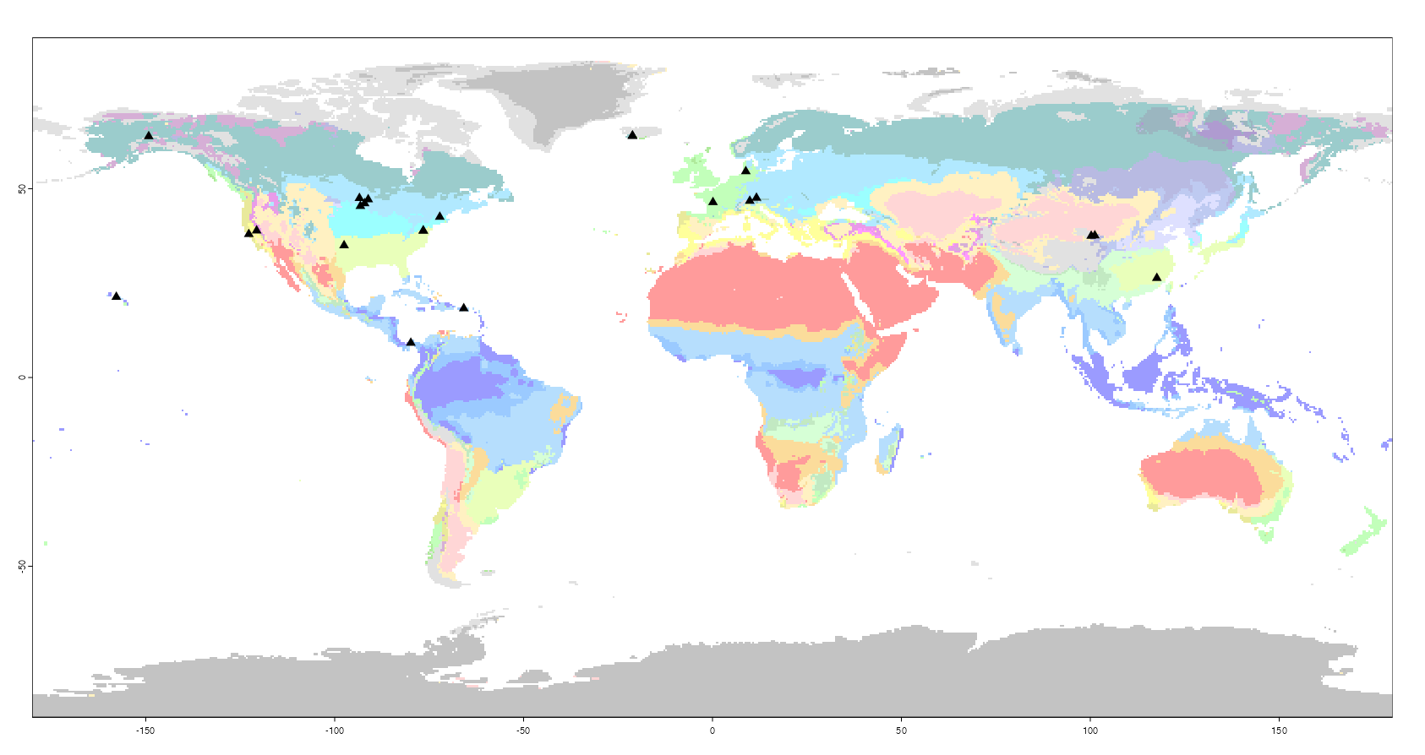
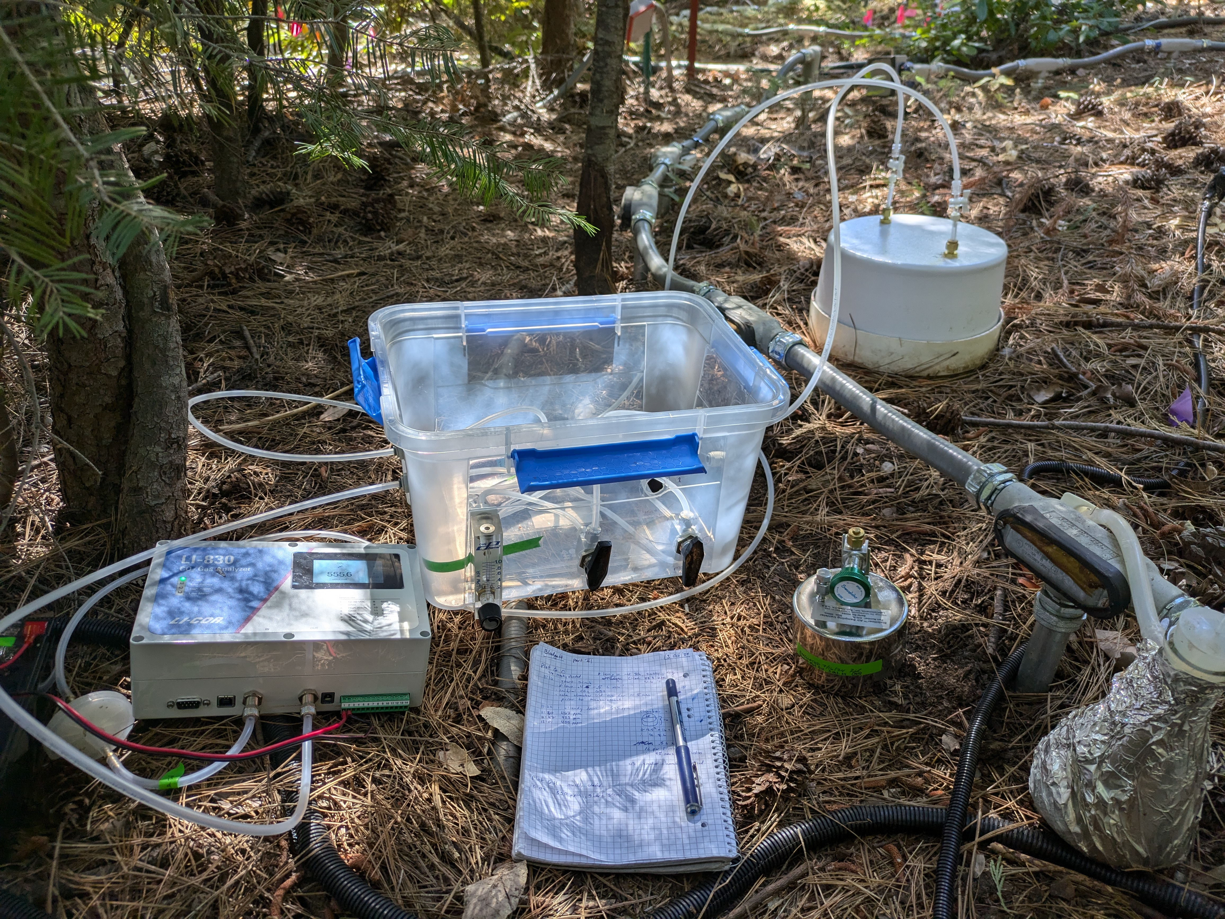
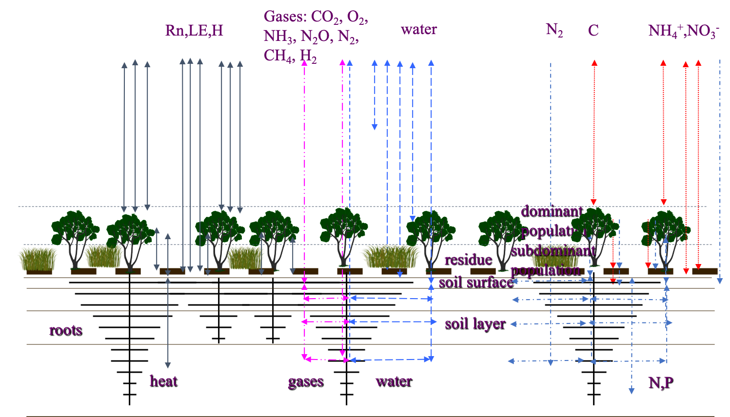
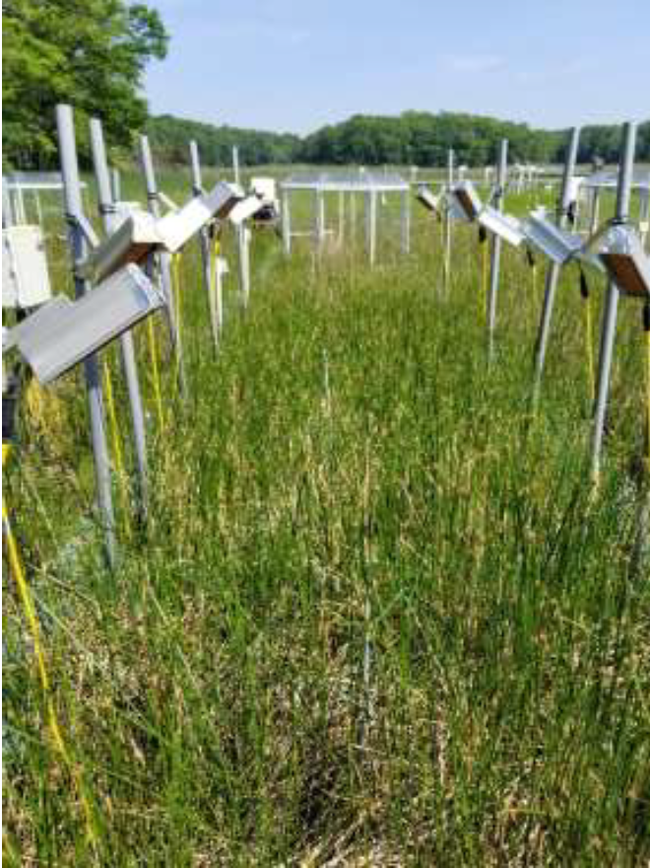
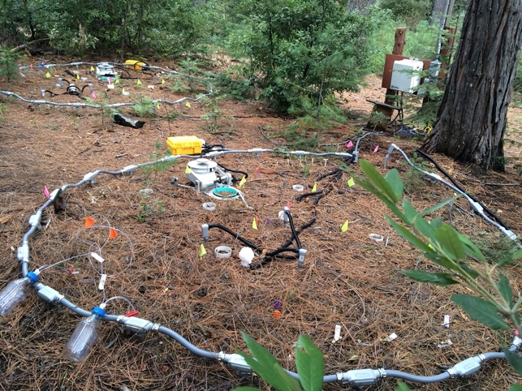
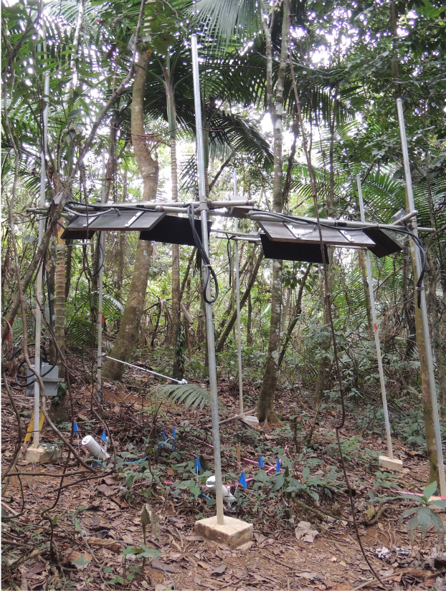
Soil
Warming
Characteristics of sites in SWEDDIE
Experiment
to Depth
`
`
`
`
`
`
Data
Integration
Effort
Is Warming Drying?
Comparing soil moisture in ecosystem warming experiments worldwide
*missing sites: FutureClim, GENX , MERIT, SMARTX
Overall mean differences in soil moisture (by depth)
J. Beem-Miller^{1,2}. A. Chabbi³, P. J. Hanson⁴, P. Reich¹, W.J. Riley², A. Schindlbacher⁵, M.W.I. Schmidt⁶, E. Schuur⁷, S.D. Frey⁸, B.D. Sigurdsson⁹, M.S. Torn¹, T. Wood¹⁰, J. Zhou¹¹, B. Zhu¹²
Background:
Q10s derived from soil warming experiments indicate potential losses by 2100¹
500
inputs
+
Change in soil C stocks by 2100
(Pg C)
250
0
-250
+ decomp
-500
Ensemble of global soil C models
Model mean
Multi-model mean
± sd
In addition to temperature, soil C inputs and soil C decomposition rates are also influenced by soil moisture
Questions:
Under what conditions does warming = drying?
What are the implications for C stock changes?
Monthly mean differences in soil moisture (by depth)
SWEDDIE sites
Adjacent SWEDDIE projects:
1) Compare the age and magnitude of heterotrophic and autotrophically respired CO₂ across sites as a function of depth
2) Acquire additional data to use sites for benchmarking ecosys model (post doc Lei Zhang at LBL)
measuring ¹⁴C-CO₂ eco at Blodgett forest (to be combined with depth-resolved incubation data
ecosys model schematic
Funding:
This material is based upon work supported by the U.S. Department of Energy, Office of Science, Office of Biological and Environmental Research under contract number DE-AC02-05CH11231
Affiliations:
University of Michigan, Institute for Global Change Biology, Ann Arbor, United States
Lawrence Berkeley National Laboratory, Climate & Ecosystem Sciences Division, Berkeley, CA, United States
INRA Institut National de la Recherche Agronomique, Paris Cedex 07, France,
Oak Ridge National Laboratory, Environmental Sciences Division and Climate Change Science Institute, Oak Ridge, TN, United States,
Bundes Forschungs Zentrum für Wald, Vienna, Austria
University of Zurich, Department of Geography, Zurich, Switzerland,
Northern Arizona University, Department of Biology, Flagstaff, AZ, United States,
University of New Hampshire, Department of Natural Resources and the Environment, Durham, United States
Agricultural University of Iceland, Borgarnes, Iceland
USDA Forest Service International Institute of Tropical Forestry, Luquillo, United States,
University of Oklahoma, Norman, United States
Institute of Ecology, College of Urban and Environmental Sciences, Peking University, Beijing, China
Notes:
45.71 = 0 h; 60.96 = 0 w; 30.48 = 1/3 h; 40.64 = 1/3 w

